Slide 1


Dr. T. THIMMAIAH INSTITUTE OF TECHNOLOGY
(Estd. 1986) Oorgaum, Kolar Gold Fields, Karnataka – 563120
(Affiliated to VTU, Belgaum, Approved by AICTE - New Delhi)
NAAC Accredited 'A' Grade, NBA Accredited (CSE, ECE, Mining Engg) Program
DEPARTMENT OF COMPUTER SCIENCE AND ENGINEERING
Project Review-2 Presentation
on
“Automatic Detection of Motorcycle Registration Number
in case of Helmet Rule Violation by Motorcyclists”
Presented By
Ajay K M 1GV21CS005
Dhanush M 1GV21CS020
Harish V 1GV21CS025
Manjunatha R 1GV21CS043
Under the Guidance of
Dr. Mohamed Kareemulla
Professor, Dept. of CSE
Dr. TTIT, K.G.F

Slide 2
Automatic Detection of Motorcycle Registration Number in case of Helmet Rule Violation by Motorcyclists 2024-25
PRESENTATION OUTLINE
IMPLEMENTATION RESULT
CONCLUSION AND FUTURE ENHANCEMENTS
Dept. of CSE, Dr.TTIT, KGF 1

Slide 3
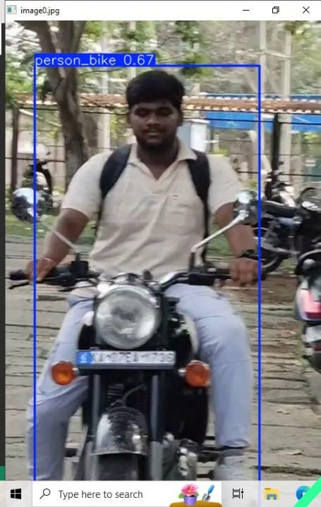
Automatic Detection of Motorcycle Registration Number in case of Helmet Rule Violation by Motorcyclists 2024-25
OUTPUT EXPLANATION
Detects person on a bike.
Dept. of CSE, Dr.TTIT, KGF 2

Slide 4
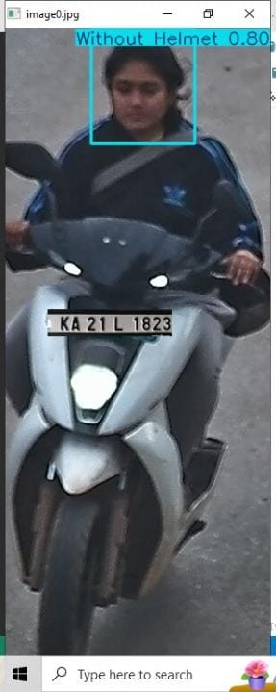
Automatic Detection of Motorcycle Registration Number in case of Helmet Rule Violation by Motorcyclists 2024-25
Detects head without helmet
Dept. of CSE, Dr.TTIT, KGF 3

Slide 5
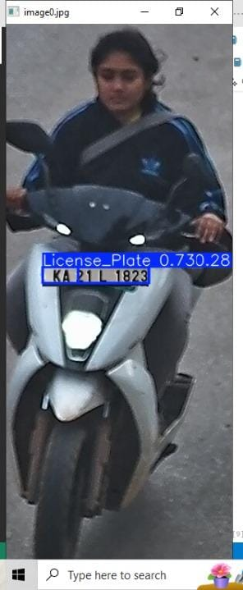
Automatic Detection of Motorcycle Registration Number in case of Helmet Rule Violation by Motorcyclists 2024-25
Detects number plate of
non-helmeted rider
Dept. of CSE, Dr.TTIT, KGF 2

Slide 6
Automatic Detection of Motorcycle Registration Number in case of Helmet Rule Violation by Motorcyclists 2024-25
COMPARSION WITH OTHER EXPLANATION
In proposed system Character Recognition included.
YOLOv8 offers higher accuracy and better real-time performance than YOLOv2/3/5.
Full end-to-end pipeline: detects non-helmeted riders, locate plates and extracts characters.
Works for both rider and passenger helmet detection-often missing in previous work.
Dept. of CSE, Dr.TTIT, KGF 7

Slide 7
Automatic Detection of Motorcycle Registration Number in case of Helmet Rule Violation by Motorcyclists 2024-25
Conclusion
By using YOLOv8 high-performance as been achieved.
Covering the entire violation pipeline.
Strong accuracy metrics (mAP@0.5 up to 0.987)
Dept. of CSE, Dr.TTIT, KGF 8

Slide 8
Automatic Detection of Motorcycle Registration Number in case of Helmet Rule Violation by Motorcyclists 2024-25
Future Enhancements
Use image super-resolution before OCR to enhance blurry plates.
It can integrate with edge devices for real-time field detection.
Convert YOLO models to ONNX or TensorRT for faster inference.
Dept. of CSE, Dr.TTIT, KGF 9

Slide 9
Automatic Detection of Motorcycle Registration Number in case of Helmet Rule Violation by Motorcyclists 2024-25
License Plate Character Recognition Module
Purpose: Recognize and extract the text from the license plate image.
Technology: Tesseract OCR (Optical Character Recognition)
Output: Registration number (text format).
Dept. of CSE, Dr.TTIT, KGF 10

Slide 10
Automatic Detection of Motorcycle Registration Number in case of Helmet Rule Violation by Motorcyclists 2024-25
Database Storage Module
Purpose: Save the detected violation details for record and future action.
Data Stored:
Rider’s Image
License Plate Number
Dept. of CSE, Dr.TTIT, KGF 11

Slide 11
Automatic Detection of Motorcycle Registration Number in case of Helmet Rule Violation by Motorcyclists 2024-25
ALGORITHM
Step 1:Start the system.
Step 2: Capture a frame from the images .
Step 3: Detect if a motorcycle is present in the frame using the first YOLOv8 model.
Step 4: Detect if a person is sitting on the motorcycle.
Step 5: Check if the rider is wearing a helmet using the second YOLOv8 model.
Step 6: Detect the license plate on motorcycle using the third YOLOv8 model.
Step 7: Crop the detected license plate region from the frame.
Step 8: Apply Tesseract OCR to the cropped license plate image.
Step 9: Store the details in database.
Dept. of CSE, Dr.TTIT, KGF 12

Slide 12
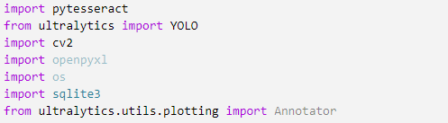
Automatic Detection of Motorcycle Registration Number in case of Helmet Rule Violation by Motorcyclists 2024-25
SAMPLE CODE
Dept. of CSE, Dr.TTIT, KGF 13

Slide 13
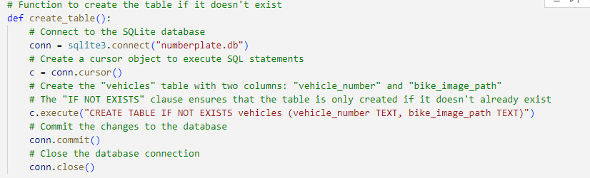
Automatic Detection of Motorcycle Registration Number in case of Helmet Rule Violation by Motorcyclists 2024-25
Dept. of CSE, Dr.TTIT, KGF 14

Slide 14
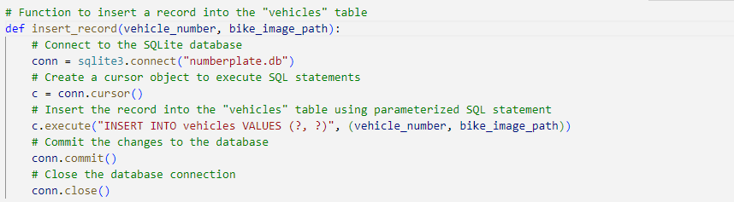
Automatic Detection of Motorcycle Registration Number in case of Helmet Rule Violation by Motorcyclists 2024-25
Dept. of CSE, Dr.TTIT, KGF 15

Slide 15
THANK YOU

